Slide 1
LIQUEFACTION-INDUCED SETTLEMENT OF SHALLOW FOUNDATIONS AND REMEDIATION: 3D NUMERICAL SIMULATION
jubin

Slide 2
Shallow Foundations on Liquefiable Soil
Liquefaction-induced tilting and settlement of buildings on shallow foundations results in significant damage, disruption of function, and considerable replacement expense.
In prototype scale, they explored the response of a rigid footing (about 4-5 m diameter) supported on liquefiable sand (Dr of about 50%, with 10m to 12.5 m saturated layer thickness).

Slide 3
In this study, the mitigation of liquefaction hazard was explored with emphasis on compaction and permeability variation of the immediate ground below the foundation.
The numerical investigation addresses the effect of compaction with and without permeability increase

Slide 4
Finite Element Formulation
The soil domain is represented by 20-8 node, effective stress fully coupled (solid-fluid) brick elements.
In this formulation, 20nodes describe the solid translational degrees of freedom, and 8 nodes describe the fluid pressure.
The compacted zone modelling parameters were chosen mainly based on extrapolating the Dr = 4O%.

Slide 5
Shallow Foundation Model
A 10 m saturated medium sand layer was studied (based on Nevada Sand at Dr of about 40%). Herein, the load (40 kPa) was simply applied at ground level in the form of a distributed surficial vertical stress over a 2 m x 2 m area.(as in figure)

Slide 6
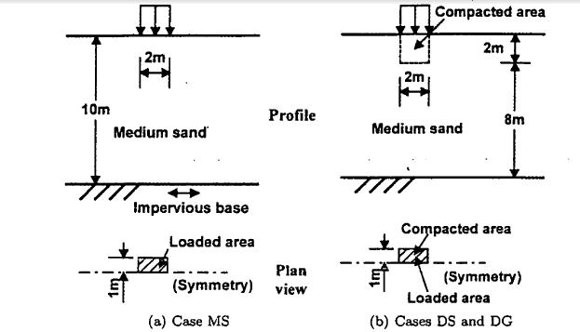
medium sand soil layer subjected to a surface load of 40 kPa

Slide 7
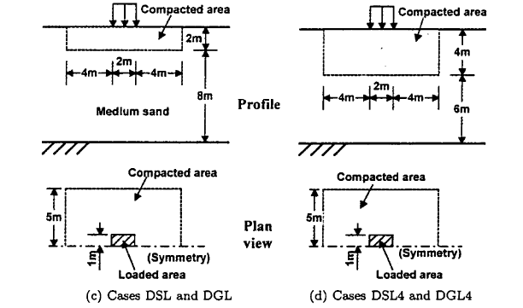

Slide 8
A half-mesh (75 elements in total) is studied. Length in the longitudinal direction is 26 m, with 13 m transversally (in this half-mesh configuration). At this preliminary stage, the employed mesh is crude geometrically, and further refinement is addressed later.
The following(solid and fluid) boundary conditions were implemented:
(i) Lateral excitation was defined along the base in the longitudinal direction (x-axis)

Slide 9
(ii) at any given depth, displacement- degrees of freedom of the left and right boundaries were tied together to reproduce a 1D shear wave propagation mechanism effect.
(iii) the soil surface was traction free, with zero prescribed pore pressure
(iv) the base and lateral boundaries were impervious.

Slide 10
The 7.5 m depth (NS direction) downhole acceleration record from the Wildlife site during the 1987 Superstition Hills earthquake was employed as base excitation along the z-axis.

Slide 11
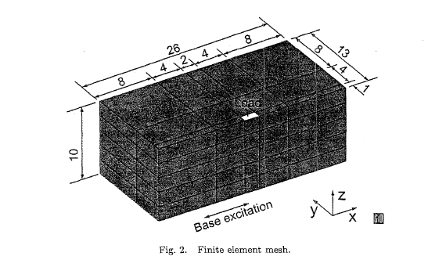
Finite element mesh

Slide 12
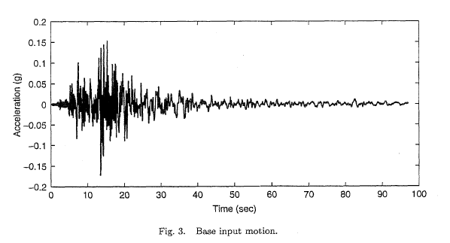
Input motion at base

Slide 13
Site Remediation
A total of eight simulations were performed. Case MSlD simulates a Medium Sand site response situation (ID shear wave propagation) with no applied surface load. The result obtained provides a reference of free-field response for the remaining cases.
Case MS is the same as MSlD with the surface load applied. This is the case which is serving as the benchmark.

Slide 14
Cases DS, DSL and DSL4 are studied to evaluate the effect of compaction (Dense Sand) for different levels of soil depth and lateral extent.
Cases DS and DSL are both compacted to 2m depth and while a Larger 10m lateral extent is compacted in Case DSL (compared to 2 m width in Case DS).
Case DSL4 is the same as Case DSL with compaction of up to 4m. Gravel permeability is used for the compacted area in Cases DG, DGL and DGL4.

Slide 15
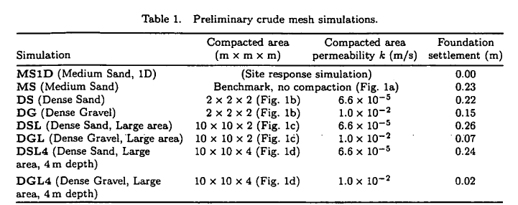

Slide 16
Simulated Foundation Settlement
However, higher permeability of the compacted area played a key role in decreasing settlement. In the case of DGL4 (dense gravel, 10 m wide and 4m deep), the foundation final settlement (Table 1) was reduced to 0.02m (compared to 0.23m in Case DSL4).

Slide 17
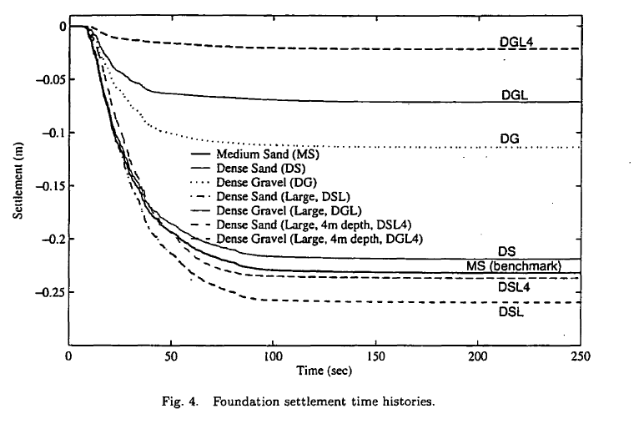
foundation settlement time histories for all conducted simulations

Slide 18
Additional observations for compaction effects :
(i)In the investigated scenario, the zone treated by compaction was virtually of no consequence.
(ii)In fact, increasing the compacted area (case of 2 m depth, DSL) actually resulted in an increased settlement which is a counter-intuitive outcome. It appears that the compacted area acted as an embedded block, ultimately resulting in a marginally larger liquefaction-induced settlement.

Slide 19
(iii)As expected, compaction to depths greater than 4 m was found to lower the total settlement by about 50% (not shown).
(iv)Increased permeability effects :
(i) High permeability right under the foundation only (DG) immediately reduced the settlement by more than 50%.
(ii) Increasing the treated zone laterally ,then also vertically eventually resulted in an order of magnitude of settlement reduction.

